Slide 1
Socket Programming
Socket Programming Overview
  Socket Programming with TCP
  Socket Programming with UDP
Python Socket Programming
Java Socket Programming
Readings: Chapter 2: Sections 2.7

Slide 2





Recap: Client-Server Communication Paradigm
Typical network app has two pieces: client and server
application
transport
network
data link
physical
Client:
initiates contact with server (“speaks first”)
typically requests service from server
request
reply
Server:
provides requested service to client
application
transport
network
data link
physical

Slide 3

Socket Programming
Goal: learn how to build client/server applications that communicate using sockets
Socket: door between application process and end-end-transport protocol
application
socket
application
controlled by
app developer
process
process
transport
transport
network
network
controlled
by OS
link
Internet
link
physical
physical

Slide 4
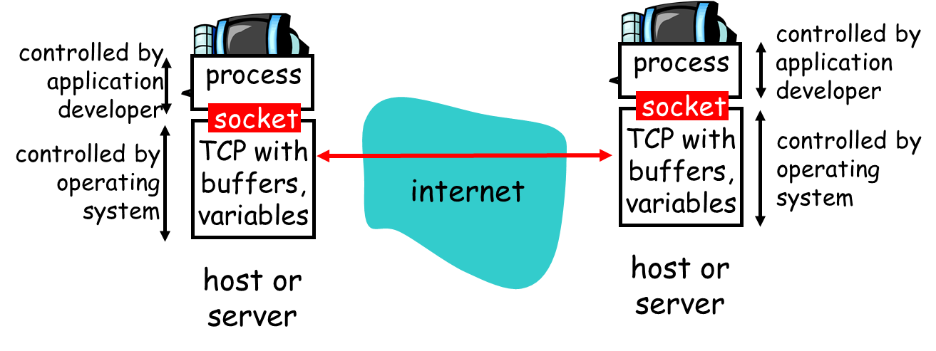
Socket Programming
Socket:
Interface between the application layer and the transport layer within a host
Analogous to a door:
  The sending process which is created in an application, shoves the messages out of the “door”

Slide 5
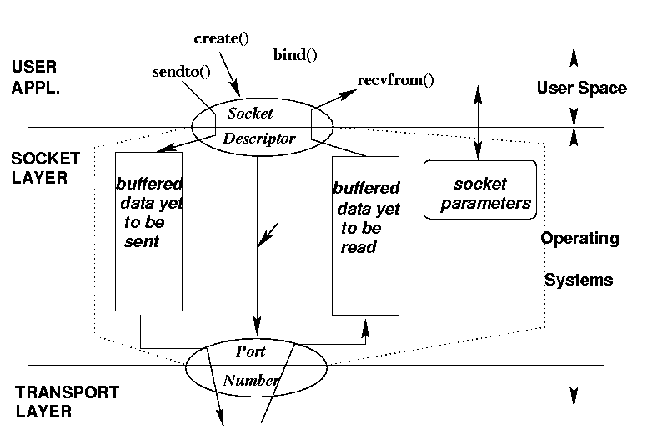
Socket Programming
Socket: conceptual view
socket()

Slide 6
Socket programming
  Two socket types for two transport services:
    UDP: unreliable datagram
    TCP: reliable, byte stream-oriented
  Application Example:
client reads a line of characters (data) from its keyboard and sends data to server
server receives the data and converts characters to uppercase
server sends modified data to client
client receives modified data and displays line on its screen

Slide 7
Socket Programming: Basics
The server application must be running before the client can send anything.
The server must have a socket through which it sends and receives messages. The client also need a socket.
Locally, a socket is identified by a port number.
In order to send messages to the server, the client needs to know the IP address and the port number of the server.
Port number is analogous to an apartment number. All doors (sockets) lead into the building, but the client only has access to one of them, located at the provided number.

Slide 8
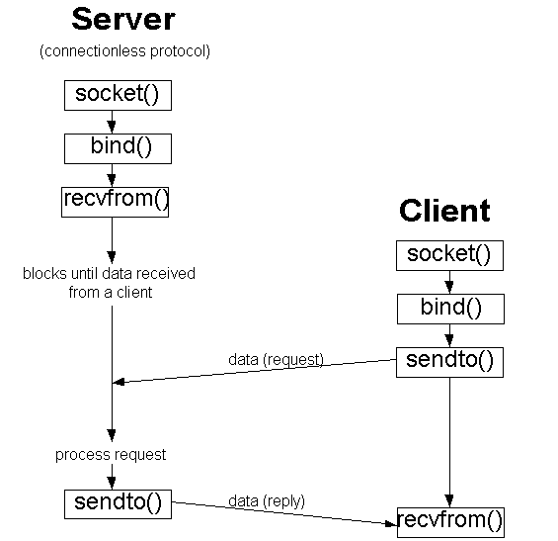
BSD Socket Programming (connectionless)

Slide 9
Socket programming with UDP
UDP: no “connection” between client & server
no handshaking before sending data
sender explicitly attaches IP destination address and port # to each packet
receiver extracts sender IP address and port# from received packet
UDP: transmitted data may be lost or received out-of-order
Application viewpoint:
UDP provides unreliable transfer of groups of bytes (“datagrams”) between client and server

Slide 10
Client/server socket interaction: UDP
server (running on serverIP)
client
create socket:
create socket, port= x:
clientSocket =
socket(AF_INET,SOCK_DGRAM)
serverSocket =
socket(AF_INET,SOCK_DGRAM)
Create datagram with server IP and
port=x; send datagram via
clientSocket
read datagram from
serverSocket
write reply to
serverSocket
specifying
client address,
port number
read datagram from
clientSocket
close
clientSocket
CSci4211: Socket Programming

Slide 11
Example app: UDP server
Python UDPServer
include Python’s socket
library
from socket import *
serverPort = 12000
serverSocket = socket(AF_INET, SOCK_DGRAM)
serverSocket.bind(('', serverPort))
print (“The server is ready to receive”)
while True:
message, clientAddress = serverSocket.recvfrom(2048)
modifiedMessage = message.decode().upper()
serverSocket.sendto(modifiedMessage.encode(),
clientAddress)
create UDP socket
bind socket to local port number 12000
Buffer size
Read from UDP socket into message, getting client’s address (client IP and port)
send upper case string back to this client

Slide 12
Example app: UDP client
Python UDPClient
include Python’s socket
library
from socket import *
serverName = ‘servername’
serverPort = 12000
clientSocket = socket(AF_INET,
SOCK_DGRAM)
message = raw_input(’Input lowercase sentence:’)
clientSocket.sendto(message.encode(),
(serverName, serverPort))
modifiedMessage, serverAddress =
clientSocket.recvfrom(2048)
print modifiedMessage.decode()
clientSocket.close()
create UDP socket for server
get user keyboard
input
Attach server name, port to message; send into socket
Buffer size
read reply characters from
socket into string
print out received string and close socket

Slide 13
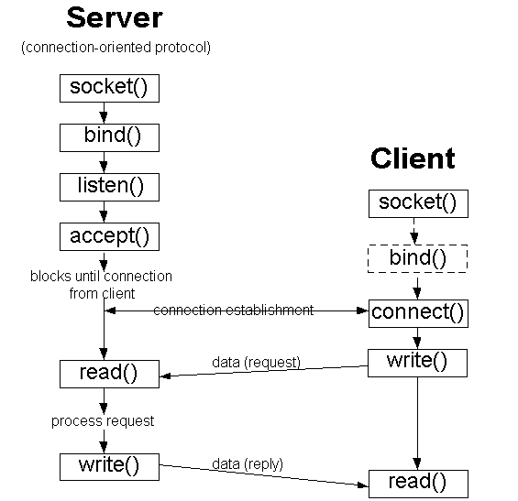
BSD Socket Programming Flows (connection-oriented)

Slide 14
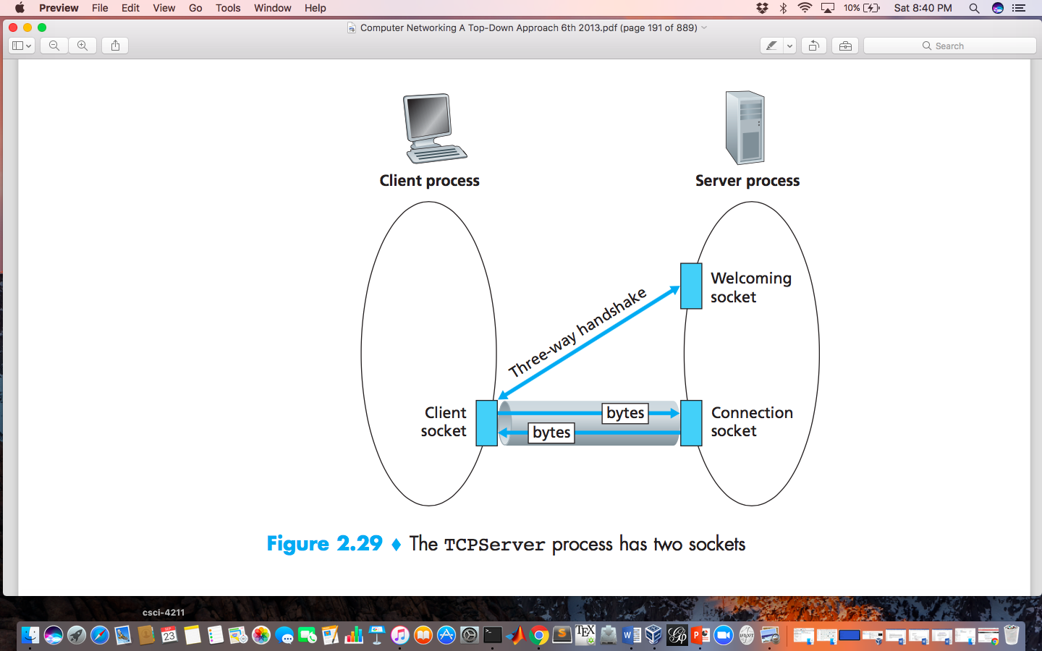
Socket programming with TCP
client must contact server
server process must first be running
server must have created socket (door) that welcomes client’s contact
client contacts server by:
Creating TCP socket, specifying IP address, port number of server process
when client creates socket: client TCP establishes connection to server TCP

Slide 15
Socket programming with TCP
when contacted by client, server TCP creates new socket for server process to communicate with that particular client
  allows server to talk with multiple clients
  source port numbers used to distinguish clients (more in Chap 3)
application viewpoint:
TCP provides reliable, in-order
byte-stream transfer (“pipe”)
between client and server

Slide 16
Client/server socket interaction: TCP
server (running on hostid)
client
create socket,
port=x, for incoming request:
serverSocket = socket()
wait for incoming
connection request
TCP
connection setup
create socket,
connect to hostid, port=x
connectionSocket =
serverSocket.accept()
clientSocket = socket()
send request using
clientSocket
read request from
connectionSocket
write reply to
connectionSocket
read reply from
clientSocket
close
connectionSocket
close
clientSocket
CSci4211: Socket Programming

Slide 17
Example app: TCP server
Python TCPServer
from socket import *
serverPort = 12000
serverSocket = socket(AF_INET,SOCK_STREAM)
serverSocket.bind((‘’,serverPort))
serverSocket.listen(1)
print ‘The server is ready to receive’
while True:
connectionSocket, addr = serverSocket.accept()
sentence = connectionSocket.recv(1024).decode()
capitalizedSentence = sentence.upper()
connectionSocket.send(capitalizedSentence.
encode())
connectionSocket.close()
create TCP welcoming
socket
server begins listening for incoming TCP requests
server waits on accept()
for incoming requests, new socket created on return
read bytes from socket
close connection to this client (but not welcoming socket)

Slide 18
Example app: TCP client
Python TCPClient
from socket import *
serverName = ’servername’
serverPort = 12000
clientSocket = socket(AF_INET, SOCK_STREAM)
clientSocket.connect((serverName,serverPort))
sentence = raw_input(‘Input lowercase sentence:’)
clientSocket.send(sentence.encode())
modifiedSentence = clientSocket.recv(1024)
print (‘From Server:’, modifiedSentence.decode())
clientSocket.close()
create TCP socket for server, remote port 12000
No need to attach server name, port

Slide 19
Java Socket Programming API
Class ServerSocket
  Connection-oriented server side socket
Class Socket
  Regular connection-oriented socket (client)
Class DatagramSocket
  Connectionless socket
Class InetAddress
  Encapsulates Internet IP address structure

Slide 20
Example: Java server (UDP)
import java.io.*;
import java.net.*;
class UDPServer {
public static void main(String args[]) throws Exception
{
DatagramSocket serverSocket = new DatagramSocket(9876);
byte[] receiveData = new byte[1024];
byte[] sendData = new byte[1024];
while(true)
{
DatagramPacket receivePacket =
new DatagramPacket(receiveData, receiveData.length);
serverSocket.receive(receivePacket);
Create
datagram socket
at port 9876
Create space for
received datagram
Receive
datagram

Slide 21
Example: Java server (UDP), cont
String sentence = new String(receivePacket.getData());
InetAddress IPAddress = receivePacket.getAddress();
int port = receivePacket.getPort();
String capitalizedSentence = sentence.toUpperCase();
sendData = capitalizedSentence.getBytes();
DatagramPacket sendPacket =
new DatagramPacket(sendData, sendData.length, IPAddress,
port);
serverSocket.send(sendPacket);
}
}
}
Get IP addr
port #, of
sender
Create datagram
to send to client
Write out
datagram
to socket

Slide 22
Example: Java client (UDP)
import java.io.*;
import java.net.*;
class UDPClient {
public static void main(String args[]) throws Exception
{
BufferedReader inFromUser =
new BufferedReader(new InputStreamReader(System.in));
DatagramSocket clientSocket = new DatagramSocket();
InetAddress IPAddress = InetAddress.getByName("hostname");
byte[] sendData = new byte[1024];
byte[] receiveData = new byte[1024];
String sentence = inFromUser.readLine();
sendData = sentence.getBytes();
Create
input stream
Create
client socket
Translate
hostname to IP
address using DNS

Slide 23
Example: Java client (UDP), cont.
Create datagram with data-to-send,
length, IP addr, port
DatagramPacket sendPacket =
new DatagramPacket(sendData, sendData.length, IPAddress, 9876);
clientSocket.send(sendPacket);
DatagramPacket receivePacket =
new DatagramPacket(receiveData, receiveData.length);
clientSocket.receive(receivePacket);
String modifiedSentence =
new String(receivePacket.getData());
System.out.println("FROM SERVER:" + modifiedSentence);
clientSocket.close();
}
}
Send datagram
to server
Read datagram
from server

Slide 24
Example: Java Server (TCP)
import java.io.*;
import java.net.*;
class TCPServer {
public static void main(String argv[]) throws Exception
{
String clientSentence;
String capitalizedSentence;
ServerSocket welcomeSocket = new ServerSocket(6789);
while(true) {
Socket connectionSocket = welcomeSocket.accept();
BufferedReader inFromClient =
new BufferedReader(new
InputStreamReader(connectionSocket.getInputStream()));
Create
welcoming socket
at port 6789
Wait, on welcoming
socket for contact
by client
Create input
stream, attached
to socket

Slide 25
Example: Java Server (TCP), cont
Create output
stream, attached
to socket
DataOutputStream outToClient =
new DataOutputStream(connectionSocket.getOutputStream());
clientSentence = inFromClient.readLine();
capitalizedSentence = clientSentence.toUpperCase() + '\n';
outToClient.writeBytes(capitalizedSentence);
}
}
}
Read in line
from socket
Write out line
to socket

Slide 26
Example: Java Client (TCP)
import java.io.*;
import java.net.*;
class TCPClient {
public static void main(String argv[]) throws Exception
{
String sentence;
String modifiedSentence;
BufferedReader inFromUser =
new BufferedReader(new InputStreamReader(System.in));
Socket clientSocket = new Socket("hostname", 6789);
DataOutputStream outToServer =
new DataOutputStream(clientSocket.getOutputStream());
Create
input stream
Create
client socket,
connect to server
Create
output stream
attached to socket

Slide 27
Example: Java Client (TCP), cont.
BufferedReader inFromServer =
new BufferedReader(new
InputStreamReader(clientSocket.getInputStream()));
sentence = inFromUser.readLine();
outToServer.writeBytes(sentence + '\n');
modifiedSentence = inFromServer.readLine();
System.out.println("FROM SERVER: " + modifiedSentence);
clientSocket.close();
}
}
Create
input stream
attached to socket
Send line
to server
Read line
from server

Slide 28
Two Different Server Behaviors
Iterative server
  At any time, only handles one client request
Concurrent server
  Multiple client requests can be handled simultaneously
  create a new process/thread to handle each request
for (;;) {
accept a client request;
handle it
}
for (;;) {
accept a client request;
create a new process / thread to handle request;
parent process / thread continues
}

Slide 29
Example of Concurrent Server
Python
import threading
def main():
…….
cx, addr = s.accept()
server = threading.Thread(target=dns, args=[cx, addr] )
server.start()
…….
……
def dns(cx,addr):
…….

Slide 30
Helpful Resources
‎Python Socket Tutorial
  https://docs.python.org/2/library/socket.html
  https://docs.python.org/3.4/library/socket.html
Java Socket Tutorial
  http://download.oracle.com/javase/tutorial/networking/sockets/
Computer Networking: A Top-Down Approach, 7th Edition. Section 2.7

